Slide 1

Predicting Diseases (Part 1 of 2)
Josh Gardner
DSC 680 Applied Data Science

Slide 2
Problem Statement
According to the news, infectious diseases are on the rise.
Sources:
Galvin, G. (26 Aug. 2019) US News. “Measles cases tick up as officials warn of possible Disneyland exposure.” Retrieved 14 Sep. 2019 from https://www.usnews.com/news/healthiest-communities/articles/2019-08-26/measles-cases-rise-to-1215-amid-disneyland-warning
Fox News. (29 Dec. 2018) “Officials warn about increased flu activity across the country.” Retrieved 14 Sep. 2019 from https://video.foxnews.com/v/5984425255001/#sp=show-clips
Centers for Disease Control and Prevention. “CDC global health in the news.” Retrieved 14 Sep. 2019 from https://www.cdc.gov/globalhealth/inthenews.htm

Slide 3
Why this is an issue
According to Baylor College of Medicine and the World Health Organization, 3 infectious diseases are in the world’s top 10 leading causes of death in 2016.
Lower respiratory infections – 3.0 million deaths
Diarrheal diseases – 1.4 million deaths
Tuberculosis – 1.3 million deaths.
Source
Baylor College of Medicine. “Introduction to infectious diseases.” Retrieved 14 Sep. 2019 from https://www.bcm.edu/departments/molecular-virology-and-microbiology/emerging-infections-and-biodefense/introduction-to-infectious-diseases

Slide 4
Research Questions
Which diseases are strongly correlated to each other?
Do preventable diseases have outbreaks during the same time periods?
Looking at past trends in the numbers of infected individuals, what are the projected number of infected individuals over the next few years?
Looking at each disease’s projected infections, which disease is likely to have the next outbreak?

Slide 5
Where data was gathered from
The data for this projected was collected from the Centers for Disease Control and Prevention, Rockland County, NYC Health, Washington State Department of Health, California Department of Public Health, City of El Paso, and the New York State Department of Health

Slide 6
Cleaning the Data
With the data coming from multiple places, the data will need to be combined into a single place and formatted.

Slide 7
Analysis Plan
Explore the data for each of the six collected diseases:
Whooping Cough
Measles
4 strains of the Flu (h3n2, h1n1, h1, and h3)
Explore how the different diseases relate to each other
Build a simple prediction for the number of newly infected for each disease
Predict which disease will have the most infections over the next few years

Slide 8

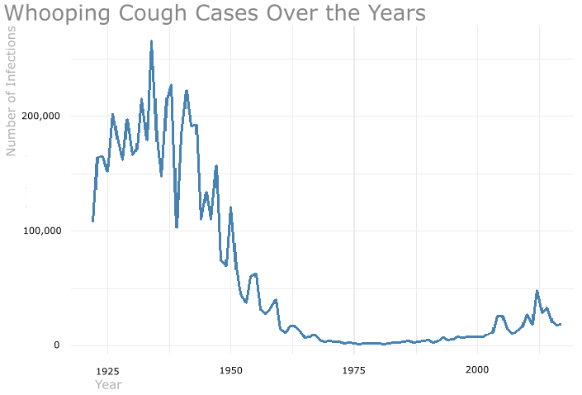
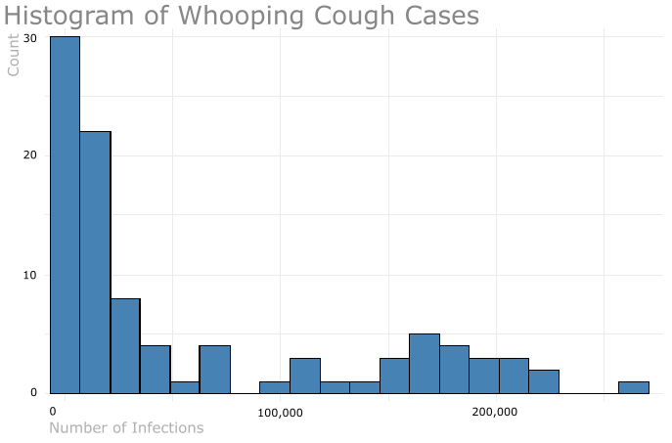
Exploring Whooping Cough
The Whooping Cough Vaccine was introduced to the public in the 1940’s.
Source
Immunization Action Coalition. “Pertussis (Whooping Cough) questions and answers.” Retrieved 19 Sep. 2019 from https://www.immunize.org/catg.d/p4212.pdf

Slide 9
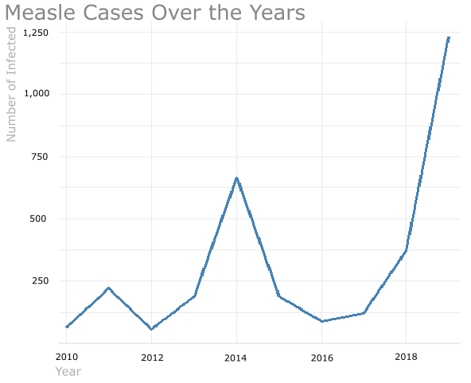
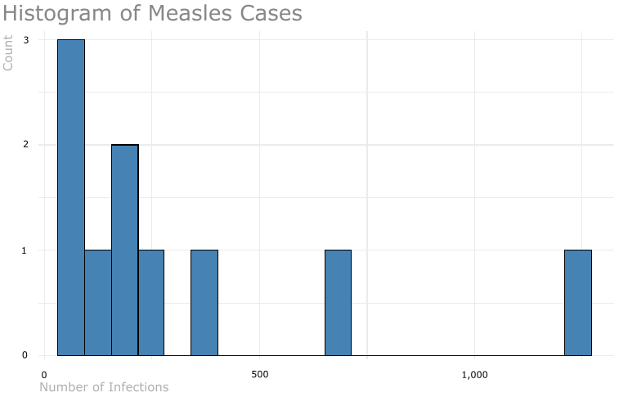
Exploring Measles
The Measles vaccine was developed in 1963.
Source
Centers for Disease Control and Prevention. “Measles (Rubeola) History of Measles.” Retrieved 19 Sep. 2019 from https://www.cdc.gov/measles/about/history.html

Slide 10
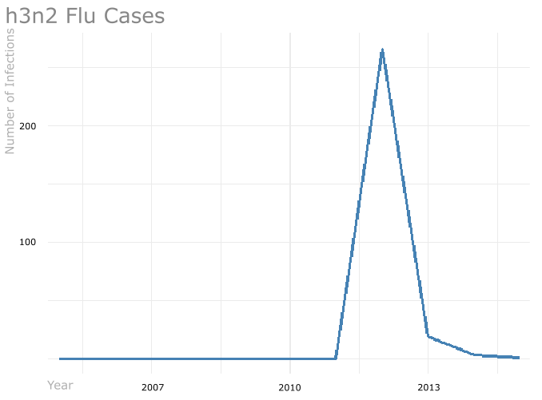
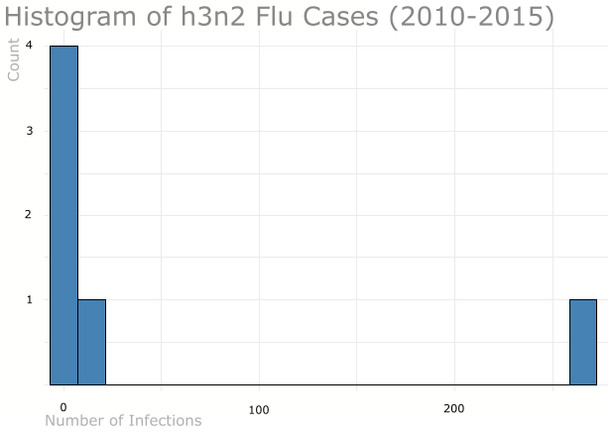
Exploring h3n2 Flu
The h3n2 Vaccine will be included in the 2019-2020 Flu Vaccine.
Source
Centers for Disease Control and Prevention. “Influenza (Flu) Upcoming 2019-2020 Flu Season.” Retrieved 19 Sep. 20190 from https://www.cdc.gov/flu/season/flu-season-2019-2020.htm

Slide 11
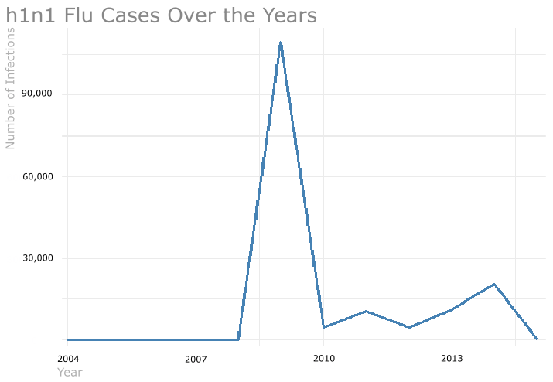
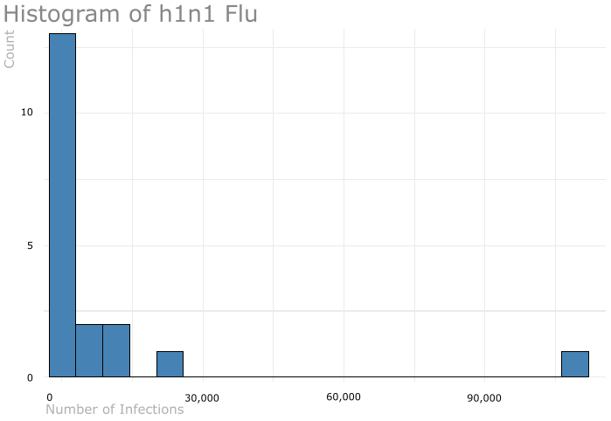
Exploring h1n1 Flu
After the 2009-2010 h1n1 pandemic, h1n1 has become a regular human flu virus and circulates seasonally worldwide.
Source
Centers for Disease Control and Protection. “H1N1 Flu.” Retrieved 19 Sep. 2019 from https://www.cdc.gov/h1n1flu/vaccination/general.htm

Slide 12
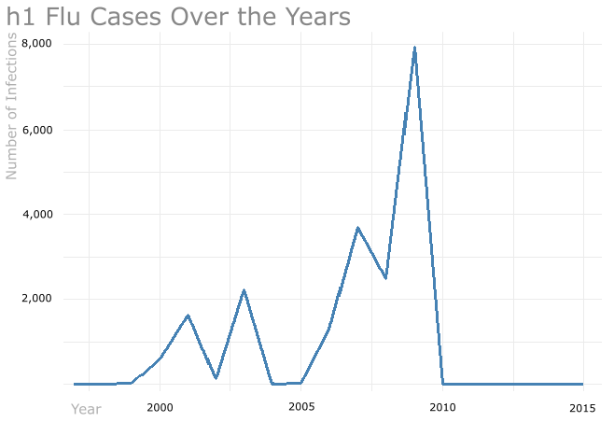
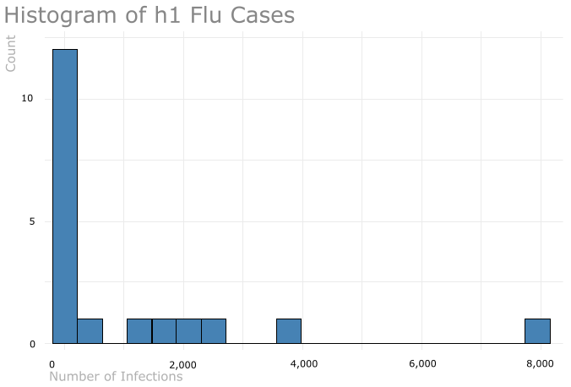
Exploring h1 Flu
The h1 Flu has been replaced by the h1n1 Flu after the 2009-2010 h1n1 Flu epidemic.
Source
Centers for Disease Control and Prevention. “Influenza (Flu) Types of Influenza Viruses.” Retrieved 19 Sep. 2019 from https://www.cdc.gov/flu/about/viruses/types.htm

Slide 13
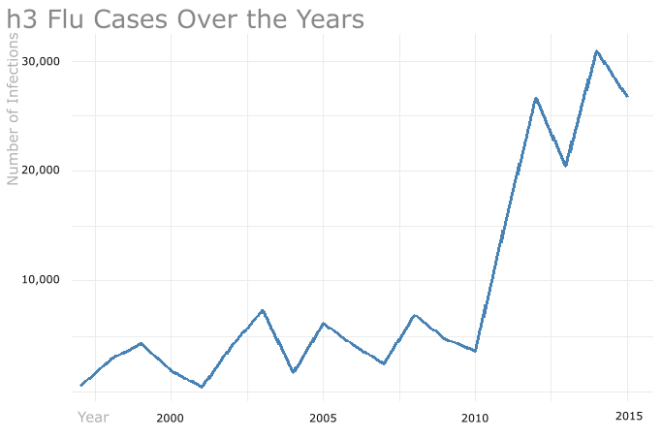
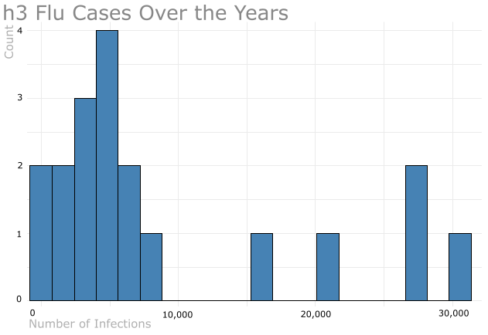
Exploring h3 Flu
The h3 Flu is considered to be more severe than h1n1 Flu.
Source
May, A. (25 Feb. 2019) USA Today. “Flu outbreak with second strain could last until May. What you need to know.” Retrieved 19 Sep. 2019 from https://www.usatoday.com/story/news/health/2019/02/25/flu-season-2019-severe-strain-rise-what-you-should-know/2978595002/

Slide 14
How the Diseases Relate to Each Other
Now we can move on to looking at how the diseases relate to each other.

